Slide 1
Forecasting using smote algorithm
ISHANI SHAH

Slide 2
“Homesite” Problem statement
Develop a model that can give them confidence that a quoted price will lead to a purchase, using an anonymized database of information on customer and sales activity, including property and coverage information

Slide 3
SMOTE
Minor class prediction

Slide 4



SMOTE rations
SMOTE is a Synthetic Minority Over-sampling Technique.
Its an oversampling method for the minority class
It works by creating synthetic samples from the minor class instead of creating copies.
I have created models with 3 different SMOTE percentages:
SMOTE = 0.4, THEN
SMOTE = 0.5, THEN
SMOTE = 0.6, THEN
On changing the SMOTE ration, the accuracy of the model will depend on the data.

Slide 5
INDIVIDUAL Models
With different Smote ratios

Slide 6
Individual models
Model | Accuracy for SMOTE=0.4 | Accuracy for SMOTE=0.5 | Accuracy for SMOTE=0.6
Decision tree – Default | 1.000000 | 1.000000 | 1.000000
Decision tree – Hypertuned | 0.962943 | 0.946225 | 0.952868
Random Forest – Default | 0.962943 | 0.994741 | 0.994951
Random Forest – Hypertuned | 0.936126 | 0.941585 | 0.966011
Multilayer Layer Perceptron – Default | 0.856988 | 0.764420 | 0.745817
Multilayer Layer Perceptron – Hypertuned | 0.714288 | 0.666667 | 0.708342
Linear SVC – Default | 0.361952 | 0.629957 | 0.675172
Linear SVC – Hypertuned | 0.714992 | 0.680521 | 0.574615
KNN – Default | 0.823290 | 0.823682 | 0.826073
KNN – Hypertuned | 0.869963 | 0.874360 | 0.876523

Slide 7
stacked model: Ensemble
With different Smote ratios

Slide 8
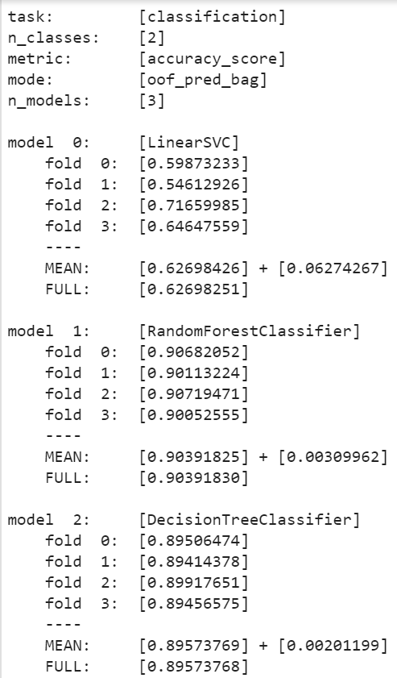
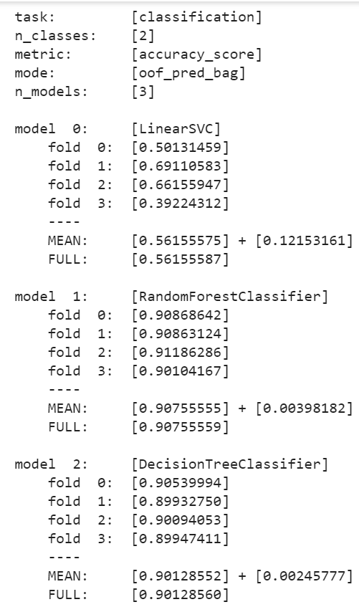
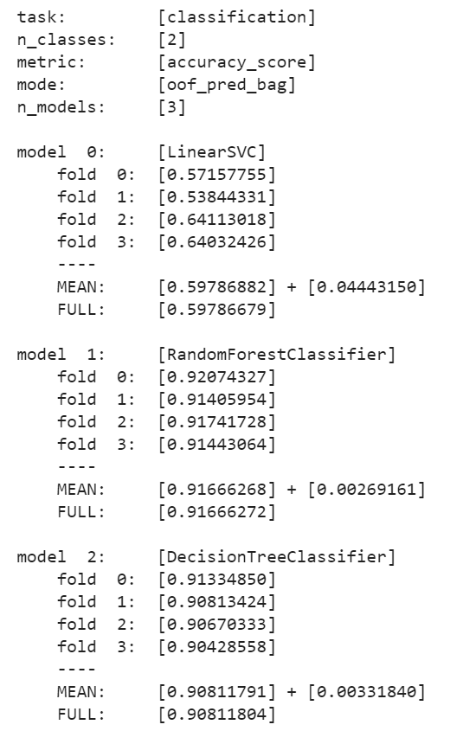
stacked model: Ensemble
SMOTE = 0.4
SMOTE = 0.5
SMOTE = 0.6
Firstly, Ensemble the following Models:
Linear SVC
Decision tree
Random Forest

Slide 9
stacked model: first layer
With different Smote ratios

Slide 10
stacked model: first layer
Model | Accuracy for SMOTE=0.4 | Accuracy for SMOTE=0.5 | Accuracy for SMOTE=0.6
Decision tree – Default | 0.90451424 | 0.90816236 | 0.91666272
Random Forest – Default | 0.90451424 | 0.90816236 | 0.91666272
Gradient Boosting – Default | 0.90451424 | 0.90816236 | 0.91666272
Linear SVC - Default | NA | 0.90755559 | NA

Slide 11
Kaggle submissions
SMOTE 0.5

Slide 12
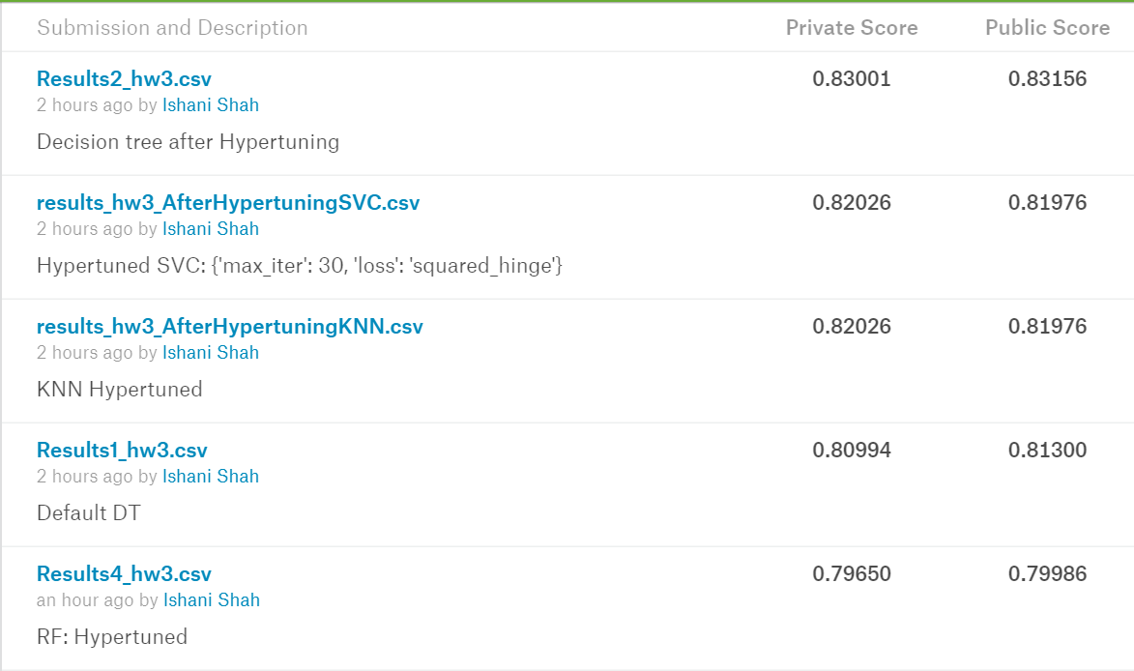
SUBMItted models
Decision Tree after Hypertuning
Linear SVC after Hypertuning
KNN after Hypertuning
Default Decision Tree
Random Forest after Hypertuning

Slide 13
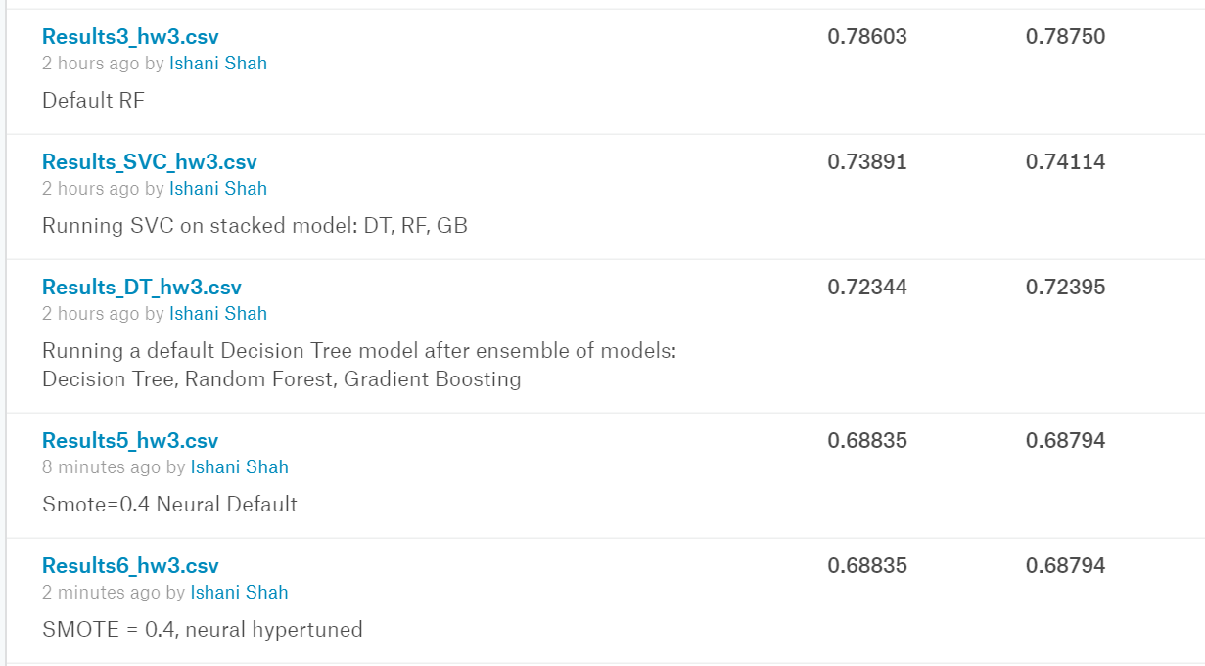
SUBMItted models
6. Default Random Forest
Linear SVC on Ensemble model
Default Decision Tree on Ensemble model
Default Neural
10. Neural after Hypertuning

Slide 14
Thank you
ISHANI SHAH

